Slide 1
Hong Kong JUG
March 2004
Java Persistence Issues
Dennis Leung
Oracle Corporation

Slide 2
About the Speaker
VP Development, OracleAS TopLink
Involved with TopLink since 1994
Presented at Java One, OracleWorld, BEA e-World, OOPSLA, Sun Tech Days, Object Expo Europe etc.
Closet Smalltalk aficionado

Slide 3
Purpose of this session
Learn and understand the impact of using J2EE with Relational Databases.
Understand issues and criteria for making effective persistence decisions.

Slide 4
Purpose of this session
AKA “How to befriend your DBA, an insiders guide for J2EE Developers/Architects/Managers”

Slide 5
Call To Action
Managing persistence related issues is the most underestimated challenge in enterprise Java today – in terms of complexity, effort and maintenance.

Slide 6
Agenda
Ways to access relational database from J2EE
Impedance Mismatch
J2EE vs DBA desires
J2EE Persistence Checklist
New object-XML support

Slide 7

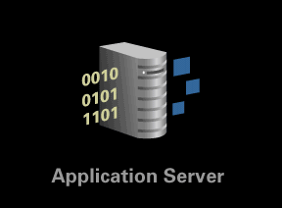
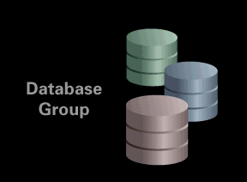
J2EE Architectures
J2EE Architecture Options
  Servlets
  JSP
  Session Beans
  Message Driven Beans
  Web Services
Bottom Line – Java application needs to access relational data somehow…

Slide 8
J2EE Access of Relational Data
Direct JDBC
  Direct SQL calls
  Use rows and result sets directly
Persistence Layer
  Accessed as objects or components
  Transparent that the data is stored in RDB
  Persistence layer in middle tier handles object-relational mapping and infrastructure
  Focus of this Session

Slide 9

JDBC
Java standard for accessing databases
JDBC is simply the database connection utilities Java developers need to build upon
JDBC
rows
SQL

Slide 10
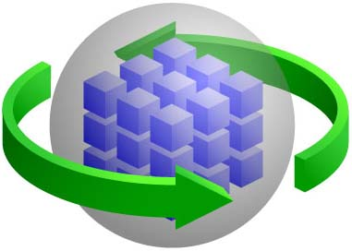

Direct JDBC
JDBC is NOT a persistence framework
  JDBC is a database connection utility
J2EE &
Web Services
  Ok for “Window on data” style application
  Ok when business logic is entrenched on database
  Little impact on RDB
  J2EE becomes nothing more than a presentation layer…
rows
SQL
JDBC
rows
SQL

Slide 11

Object Persistence Layer
Abstracts persistence details from the application layer, supports Java objects/Entity Beans
J2EE &
Web Services
object-level
querying and creation
results are objects
object creation and
updates through
object-level API
Objects
Objects
Persistence Layer
results are
returned as
raw data
JDBC
API uses SQL
or database
specific calls
rows
SQL

Slide 12
Impedance Mismatch
The differences in relational and object technology is know as the “object-relational impedance mismatch”
Challenging problem to address because it requires a combination of relational database and object expertise

Slide 13
Impedance Mismatch
Factor
J2EE
Relational Databases
Logical Data Representation
Objects, methods, inheritance
Tables, SQL, stored procedures
Scale
Hundreds of megabytes
Gigabytes, terabytes
Relationships
Memory references
Foreign keys
Uniqueness
Internal object id
Primary keys
Key Skills
Java development, object modeling
SQL, Stored Procedures, data management
Tools
IDE, Source code management, Object Modeler
Schema designer, query manager, performance profilers, database configuration

Slide 14
Object Level Options
Depends on what component architecture is used:
  Entity Beans BMP – Bean Managed Persistence
  Entity Beans CMP – Container Managed Persistence
  POJO – “Plain Ol’ Java Objects” via Persistence Layer
    May be “home-grown” following “DAO” Data Access Object patterns
    May use commercial or open source product (JDO vendor, Hibernate, Cocobase, TopLink)

Slide 15
Entity Beans or POJO?
Hot topic – Should you use Entity Beans or POJO?
If we use Entity Beans – CMP or BMP?
If we use POJO – DAO, JDO, 3rd Party?
Not relevant to this discussion! The issues to be discussed apply regardless of component type or architecture used.

Slide 16
J2EE Developer Desires
Data model should not constrain object model
Don’t want database code in object/component code
Accessing data should be fast
Minimize calls to database – they are expensive
Object-based queries – not SQL
Isolate J2EE app from schema changes
Notification of changes to data occurring at database

Slide 17
DBA Desires
Adhere to rules of database
  referential integrity, stored procedures, sequence numbers etc.
Build the J2EE application but do NOT expect to change schema
Build the J2EE application but the schema might change
Let DBA influence/change database calls/SQL generated to optimize
Be able to profile all SQL calls to database
Leverage database features where appropriate (outer joins, sub queries, specialized database functions)

Slide 18
Differences
Desires are contradictory
  “Insulate application from details of database but let me leverage the full power of it”
  Different skill sets
  Different methodologies
  Different tools
Technical differences must also be considered!

Slide 19
How Are Databases Affected?
In practice, it’s usually the other way around, J2EE app is influenced by database…
  Database “rules” need to be followed
  Database interaction must be optimized for performance
  “Source of truth” for data integrity is database, not app server

Slide 20
J2EE Persistence Checklist
Mappings
Object Traversal
Queries
Transactions
Optimized database interaction
Locking
Caching
Database features

Slide 21
Mapping
Object model and Schema must be mapped
  True for most persistence approaches
Most contentious issue facing designers
  Which classes map to which table(s)?
  How are relationships mapped?
  What data transformations are required?

Slide 22
Data and Object Models
Rich, flexible mapping capabilities provide data and object models a degree of independence
Otherwise, business object model will force changes to the data schema or vice-versa
Often, J2EE component models are nothing more than mirror images of data model or vice versa – NOT desirable

Slide 23
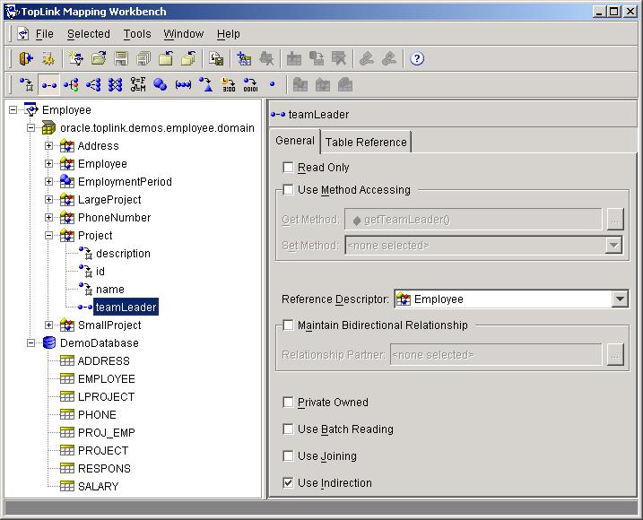
Mapping Tools
The underlying mapping flexibility is very important

Slide 24
Simple Object Model
Customer
id: int
name: String
creditRating: int
1:1 Relationship
*
Address
id: int
city: String
zip: String

Slide 25
Typical 1-1 Relationship Schema
CUST
ID
NAME
C_RATING
A_ID
ADDR
ID
CITY
ZIP

Slide 26
Other possible Schemas…
CUST
ADDR
ID
NAME
C_RATING
ID
CITY
ZIP
C_ID
CUST
ADDR
CUST_ADDR
ID
NAME
C_RATE
C_ID
ID
CITY
ZIP
C_ID
A_ID
CUST
ID
NAME
C_RATING
CITY
ZIP

Slide 27
Even More Schemas…
CUST
CUST_CREDIT
CUST
CUST_CREDIT
ID
NAME
ID
C_RATING
ID
NAME
A_ID
ID
C_RATING
ADDR
ADDR
ID
CITY
ZIP
ID
CITY
ZIP
C_ID
CUST
CUST_CREDIT
CUST
CUST_CREDIT
ID
NAME
ID
C_RATING
A_ID
ID
NAME
ID
C_RATING
ADDR
ID
CITY
ZIP
ADDR
ID
CITY
ZIP
C_ID
CUST
CUST_CREDIT
ID
NAME
CC_ID
ID
C_RATING
A_ID
ADDR
ID
CITY
ZIP

Slide 28
Mapping Summary
Just showed nine valid ways a 1-1 relationship could be represented in a database
  Most persistence layers and application servers will only support one
Without good support, designs will be forced
Imagine the flexibility needed for other mappings like 1-M and M-M

Slide 29
Object Traversal – Lazy Reads
J2EE Applications work on the scale of a few hundreds of megabytes
Relational databases routinely manage gigabytes and terabytes of data
Persistence layer must be able to transparently fetch data “just in time”

Slide 30
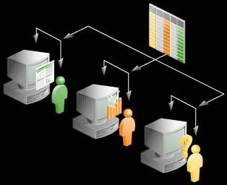
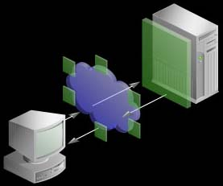
Just in Time Reading – Faulting Process
Accessing relationship for first time
Customer
Proxy
Get related object based on FK
Plug result into Proxy
SQL if not cached
Check Cache
Order
Order
Notes:
The whole process, 2-4 should be transparent to the developer.

Slide 31
Object Traversals
Even with lazy reads, object traversal is not always ideal
  To find a phone number for the manufacturer of a product that a particular customer bought, may do several queries:
    Get customer in question
    Get orders for customer
    Get parts for order
    Get manufacturer for part
    Get address for manufacturer
  Very natural object traversal results in 5 queries to get data that can be done in 1

Slide 32
N+1 Reads Problem
Many persistence layers and application servers have an N+1 reads problem
Causes N subsequent queries to fetch related data when a collection is queried for
A side effect of the impedance mismatch and poor mapping and querying support in persistence layers

Slide 33
N+1 Reads Problem
C
C
C
C
Pool of Created
Objects or Beans
2
findByCity()
1
3
Returns collection
findByCity()
Persistence
Layer or EJB
Container
n
For each Customer
Fetch their Address
4
4
6
n
Container returns results
Address
5
5
If Address had related objects, they too may be fetched 2n+1 Reads!

Slide 34
N+1 Reads
Must have solution to minimize queries
Need flexibility to reduce to 1 query, 1+1 query or N+1 query where appropriate
  1 Query when displaying list of customers and addresses – known as a “Join Read”
  1+1 Query when displaying list of customers and user may click button to see addresses – known as a “Batch Read”
  N+1 Query when displaying list of customers but only want to see address for selected customer

Slide 35
Queries
Java developers are not usually SQL experts
  Maintenance and portability become a concern when schema details hard-coded in application
Allow Java based queries that are translated to SQL and leverage database options
employee.manager.address = someAddress
  SELECT * FROM EMP t1, EMP t2, ADDR t3 WHERE t1.MGR_ID = t2.EMP_ID AND t2.ADDR_ID = t3.ADDR_ID AND t3.ADDR_ID = <someAddress.id>

Slide 36
Query Requirements
Must be able to trace and tune SQL
Must be able use ad hoc SQL where necessary
Must be able to leverage database abilities
  Outer joins
  Nested queries
  Stored Procedures
  Oracle Hints

Slide 37
Transaction Management
J2EE apps typically support many clients sharing small number of db connections
Ideally would like to minimize length of transaction on database
Begin Txn
Time
Begin Txn
Commit Txn
Commit Txn

Slide 38
Database Triggers
Database triggers will be completely transparent to the J2EE application
However, their effects must be clearly communicated and considered
Example: Data validation –> audit table
  Objects mapped to an audit table that is only updated through triggers, must be read-only on J2EE

Slide 39
Database Triggers
More challenging when trigger updates data in the same row and the data is also mapped into an object
Example: Annual salary change automatically triggers update of life insurance premium payroll deduction
  J2EE app would need to re-read payroll data after salary update OR
  Duplicate business logic to update field to avoid re-read
  Saves a DB call but now business logic in 2 places

Slide 40
Cascaded Deletes
Cascaded deletes done in the database have a real effect on what happens at J2EE layer
Middle tier app must:
  Be aware a cascaded delete is occurring
  Determine what the “root” object is
  Configure persistence settings or application logic to avoid deleting related objects already covered by cascaded delete

Slide 41
Referential Integrity
Java developers manipulate object model in a manner logical to the business domain
May result in ordering of INSERT, UPDATE and DELETE statements that violate database constraints
Persistence layer should automatically manage this and allow options for Java developer to influence order of statements

Slide 42
Caching
Any application that caches data, now has to deal with stale data
When and how to refresh?
Will constant refreshing overload the database?
Problem is compounded in a clustered environment
App server may want be notified of database changes

Slide 43
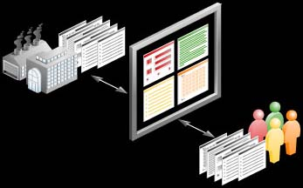
Caching
SQL Query (if needed)
OO Query
Results(s)
NO – Build bean/object from results
Does PK for row exist in cache?
Return object results
YES – Get from Cache
Notes:
Cache Limitations
Can’t always check the cache first
In memory queries are possible, but expensive
Read-many: we can’t know if we have all of them in cache
Cache behavior is class specific
Some objects can be fully cached at all times
Other objects need to be refreshed
regularly
Cache Management
When do we refresh if database is shared?
On transaction boundaries?
Explicit user requests?
Notification from another server?
When do we remove entries?
Time-based or Least-recently used?
No longer referenced?

Slide 44
Locking
J2EE Developers want to think of locking at the object level
Databases may need to manage locking across many applications
Persistence layer or application server must be able to respect and participate in locks at database level

Slide 45
Optimistic Locking
DBA may wish to use version, timestamp and/or last update field to represent optimistic lock
  Java developer may not want this in their business model
  Persistence layer must be able to abstract this
Must be able to support using any fields including business domain

Slide 46
Pessimistic Locking
Requires careful attention as a JDBC connection is required for duration of pessimistic lock
Should support SELECT FOR UPDATE [NOWAIT] semantics
Begin Txn
Time
Pess Lock
Begin Txn
Commit Txn
Commit Txn

Slide 47
Other Impacts
Use of special types
  BLOB, Object Relational
Open Cursors
Batch Writing
Sequence number allocations

Slide 48
Summary of O/R
J2EE apps accessing relational databases:
  Don’t need to compromise object/data model
  Need to fully understand what is happening at database level
  Can utilize database features
  Do not have to hard code SQL to achieve optimal database interaction
  Can find solutions that effectively address persistence challenges and let developers focus on J2EE application

Slide 49
TopLink XML
Solves Object-to-XML mismatch (similar to Object-to-Relational mismatch)
Address needs of those wanting an abstract business object representation of XML data
XML is preferred data format for JCA resource adapters
  Minimize proprietary data exchange formats
Available now in 10.0.3 Developer Preview

Slide 50
TopLink XML – Problem Space
XML documents are not the ideal programmatic format to be implementing complex business logic, objects are -> Object-XML impedance mismatch
Growing pervasiveness of XML in enterprise applications increases occurrence of this problem
XML data binding is potential performance and development bottleneck

Slide 51
XML in J2EE
XML documents can be represented at different levels of abstractions in J2EE applications:
  Parsed document (DOM, SAX …) - parser
  Unmanaged Java objects from non-transactional data source – data converter
  Managed Java objects from a transactional data source – persistence manager

Slide 52
3 Levels of XML Representation
DOM
Unmanaged
Object
Managed
Object/EJB
Persistence Manager
O-X Data Converter
XML Parser
XML
Document
JDBC
J2C
File
XDB
EIS
Web
Service
BPM
JMS

Slide 53
Application Uses of O-X
Similar to how direct JDBC coding is not desirable in all cases, an object level interface is valuable for building applications accessing XML
  Web Services
  EIS data sources using JCA resource adapters
    XML based adapters will outgrow those using proprietary data formats
  Data integration
    Integrated format is XML – mid-tier data synthesis
  Application integration
    Where programmatic business processing is required on data moving between applications

Slide 54
TopLink XML Solution
Full O-X Persistence Layer & tooling
  Mapping, Tools support, performance, caching, Transaction support
Heterogeneous data source supported
    Relational
    XML (and XML enabled sources – JCA)
Includes JAXB Implementation
  Provides migration path from simple needs to much more sophisticated O-X requirements

Slide 55
TopLink XML Advantages
Developer can control how objects are mapped to XML Schema
Full GUI tool to define mapping and configure run time
Heterogeneous data sources support
  XML, relational, EIS
Extends existing rich persistence product functionality
Supports both Java objects and Entity Beans

Slide 56
TopLink Support beyond JAXB
Similar benefits to TopLink’s O-R
  More flexible mapping types
  Independence between object model and XML schema
  GUI interface for defining mappings
  Non-intrusive into persistent classes
  Development flexibility
    Developer could start with an existing model
    Able to code business logic into model

Slide 57
Sample Object Model
Order
Address
id: long
orderedBy: String
1
addressee: String
city: String
apartment: String
street: String
state: String
country: String
zipCode: String
address
*
lineItems
LineItem
lineNumber: long
itemName: String
quantity: long
itemPrice: BigDecimal

Slide 58
Direct Mapping
Maps object attributes directly to simple XML attributes/elements
: Address
<ORDER ORDER_ID="1234">
<ORDERED_BY>Jane Doe</ORDERED_BY>
<ADDRESS>
...
</ADDRESS>
<LINES>
...
</LINES>
<LINES>
...
</LINES>
</ORDER>
: Order
id = 1234
orderedBy = “Jane Doe”
: LineItem
: LineItem

Slide 59
Composite Object Mapping
: Address
<ORDER ORDER_ID="1234">
<ORDERED_BY>Jane Doe</ORDERED_BY>
<ADDRESS>
...
</ADDRESS>
<LINES>
...
</LINES>
<LINES>
...
</LINES>
</ORDER>
: Order
id = 1234
orderedBy = “Jane Doe”
: LineItem
: LineItem

Slide 60
Composite Collection Mapping
: Address
<ORDER ORDER_ID="1234">
<ORDERED_BY>Jane Doe</ORDERED_BY>
<ADDRESS>
...
</ADDRESS>
<LINES>
...
</LINES>
<LINES>
...
</LINES>
</ORDER>
: Order
id = 1234
orderedBy = “Jane Doe”
: LineItem
: LineItem

Slide 61
Positional Information
Similarly named elements are unique depending on position
TopLink XML
: Address
<ADDRESS>
<ADDRESSEE>Jane Doe</ADDRESSEE>
<STREET>Apt. #123</STREET>
<STREET>123 Some St.</STREET>
…
</ADDRESS>
addressee = “Jane Doe”
apartment = “Apt. #123”
street = “123 Some St.”
…
JAXB/Class Generation
: Address
<ADDRESS>
<ADDRESSEE>Jane Doe</ADDRESSEE>
<STREET>Apt. #123</STREET>
<STREET>123 Some St.</STREET>
…
</ADDRESS>
addressee = “Jane Doe”
street = {“Apt. #123”,
“123 Some St.”}
…

Slide 62
Path Information
Does not require objects to be created for every level of nesting
TopLink XML
: LineItem
<LINES LINE_NO="1">
<ITEM>
<NAME>Pens</NAME>
<PRICE>2.50</PRICE>
</ITEM>
<QUANTITY>50</QUANTITY>
</LINES>
lineNumber = 1
itemName = “Pens”
itemPrice = 2.50
quantity = 50
JAXB/Class Generation
: Lines
: Item
<LINES LINE_NO="1">
<ITEM>
<NAME>Pens</NAME>
<PRICE>2.50</PRICE>
</ITEM>
<QUANTITY>50</QUANTITY>
</LINES>
lineNumber = 1
quantity = 50
name = “Pens”
price = 2.50

Slide 63
Employee Class Model
Employee
Address
gender: String
tasks: Vector
normalHours: Calendar[]
1
address
*
phoneNumbers
dependents
PhoneNumber
*
Dependent
areaCode: Object
number: Object

Slide 64
Direct Collection Mapping
Maps a collection of simple types to a collection of elements
: Employee
<EMPLOYEE>
<TASK>this</TASK>
<TASK>that</TASK>
<TASK>other thing</TASK>
</EMPLOYEE>
tasks = “this”, “that”,
“other thing”

Slide 65
Object Type Converter
Map a fixed set of values in their object model to a fixed set of
values in their data model
: Employee
“Female” to “F”
“Male” to “M”
<EMPLOYEE>
<GENDER>F</GENDER>
</EMPLOYEE>
gender = “Female”

Slide 66
Transformation Mapping
Allows custom definition of mapping via methods
Unmarshal (Read)
<EMPLOYEE>
<START-TIME>9:00:00</START-TIME>
<END-TIME>17:00:00</END-TIME>
</EMPLOYEE>
: Employee
: AttributeTransformer
normalHours
= {9am,5pm}
Marshal (Write)
: Employee
: FieldTransformer
<EMPLOYEE>
<START-TIME>9:00:00</START-TIME>
<END-TIME>17:00:00</END-TIME>
</EMPLOYEE>
normalHours
= {9am,5pm}
: FieldTransformer

Slide 67
Simple Type Translator
Stores "typing" information for ambiguous object attribute types
Class Model
PhoneNumber
<element name=“AREA-CODE” type=“anySimpleType”/>
<element name=“NUMBER” type=“anySimpleType”/>
areaCode: Object
number: Object
Instance Model
: PhoneNumber
<PHONE-NUMBER>
<AREA-CODE xsi:type=“xsd:int”>613</AREA-CODE>
<NUMBER xsi:type=“xsd:string”>KL51234</NUMBER>
</PHONE-NUMBER>
areaCode = 613
number = “KL51234”

Slide 68
Namespace Support
Supports documents that are defined by multiple schemas
<abc:EMPLOYEE xmlns:abc=“http://X” xmlns:def=“http://Y”>
<def:FIRST-NAME>Jane</def:FIRST-NAME>
<def:LAST-NAME>Doe</def:LAST-NAME>
</abc:EMPLOYEE>
: Employee
firstName = “Jane”
lastName = “Doe”
<ns1:EMPLOYEE xmlns:ns1=“http://X” xmlns:ns2=“http://Y”>
<ns2:FIRST-NAME>Jane</ns2:FIRST-NAME>
<ns2:LAST-NAME>Doe</ns2:LAST-NAME>
</ns1:EMPLOYEE>
Employee Default Root = abc:EMPLOYEE
XPath firstName = def:FIRST-NAME
XPath lastName = def:LAST-NAME
Namespace Resolver:
abc = http://X
def = http://Y

Slide 69
Complex Type Inheritance
Class
Model
Address
<element name=“ADDRESS” type=“ADDRESS-TYPE”/>
<complexType name=“ADDRESS-TYPE”>
…..
</complexType>
<complexType name=“CANADIAN-ADDRESS-TYPE>
<complexContent>
<extension base=“ADDRESS-TYPE”>
…
</extension>
</complexContent>
</complexType>
street: String
city: String
CanadianAddress
province: String
postalCode: String
Instance
Model
: CanadianAddress
<ADDRESS xsi:type=“CANADIAN-ADDRESS-TYPE”>
<STREET>123 Any St.</STREET>
<CITY>Ottawa</CITY>
<PROVINCE>ON</PROVINCE>
<POSTAL-CODE>A1B 2C3</POSTAL-CODE>
</EMPLOYEE>
street = “123 Any St.”
city = “Ottawa”
province = “ON”
postalCode = “A1B 2C3”

Slide 70
O-X Future Features
Inter-document relationships
  Similar to foreign keys using key/key ref
DOM access to object model
  Changes in DOM reflected in object
Generation of XML Schema from object model
Xquery/Xpath
  Execute query against document, return objects
Substitution groups – element subsitution
  Enhance inheritance support
Lots of others
  Priorities?

Slide 71

otn.oracle.com
Join Over 3,000,000 Developers!
Free Technical Advice
Free Software Downloads
http://otn.oracle.com

Slide 72
Q
&
A
Q U E S T I O N S
A N S W E R S

